Slide 1
Time Series Analysis

Slide 2
Examples of time series analysis in action include:
Weather data
Rainfall measurements
Temperature readings
Heart rate monitoring (EKG)
Brain monitoring (EEG)
Quarterly sales
Stock prices
Automated stock trading
Industry forecasts
Interest rates

Slide 3
Trend: In which there is no fixed interval and any divergence within the given dataset is a continuous timeline. The trend would be Negative or Positive or Null Trend
Seasonality: In which regular or fixed interval shifts within the dataset in a continuous timeline. Would be bell curve or saw tooth
Cyclical: In which there is no fixed interval, uncertainty in movement and its pattern
Irregularity: Unexpected situations/events/scenarios and spikes in a short time span.

Slide 4
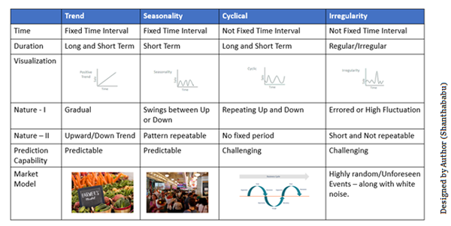

Slide 5
Data Types of Time Series
Let’s discuss the time series’ data types and their influence. While discussing TS data types, there are two major types – stationary and non-stationary.
Stationary: A dataset should follow the below thumb rules without having Trend, Seasonality, Cyclical, and Irregularity components of the time series.
The mean value of them should be completely constant in the data during the analysis.
The variance should be constant with respect to the time-frame
Covariance measures the relationship between two variables.
Non- Stationary: If either the mean-variance or covariance is changing with respect to time, the dataset is called non-stationary.

Slide 6
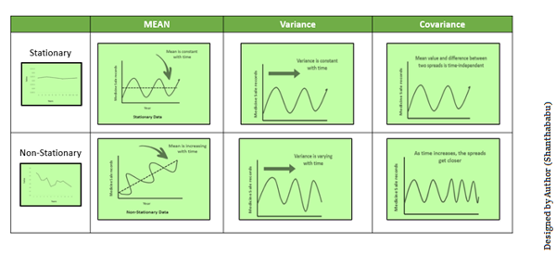

Slide 7
Methods to Check Stationarity
During the TSA model preparation workflow, we must assess whether the dataset is stationary or not. This is done using Statistical Tests. There are two tests available to test if the dataset is stationary:
Augmented Dickey-Fuller (ADF) Test
Kwiatkowski-Phillips-Schmidt-Shin (KPSS) Test
Augmented Dickey-Fuller (ADF) Test or Unit Root Test
The ADF test is the most popular statistical test. It is done with the following assumptions:
Null Hypothesis (H0): Series is non-stationary
Alternate Hypothesis (HA): Series is stationary
p-value >0.05 Fail to reject (H0)
p-value <= 0.05 Accept (H1)
Kwiatkowski–Phillips–Schmidt–Shin (KPSS) Test
These tests are used for testing a NULL Hypothesis (HO) that will perceive the time series as stationary around a deterministic trend against the alternative of a unit root. Since TSA is looking for Stationary Data for its further analysis, we have to ensure that the dataset is stationary.

Slide 8
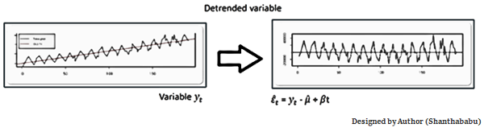
Converting Non-Stationary Into Stationary
Let’s discuss quickly how to convert non-stationary to stationary for effective time series modeling. There are three methods available for this conversion – detrending, differencing, and transformation.
Detrending
It involves removing the trend effects from the given dataset and showing only the differences in values from the trend. It always allows cyclical patterns to be identified.

Slide 9
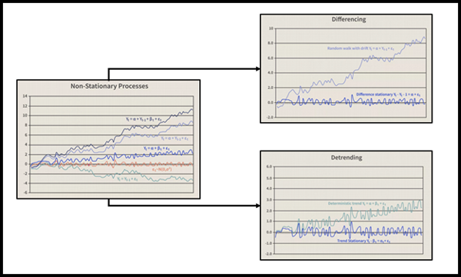
Differencing
This is a simple transformation of the series into a new time series, which we use to remove the series dependence on time and stabilize the mean of the time series, so trend and seasonality are reduced during this transformation.
Yt= Yt – Yt-1
Yt=Value with time

Slide 10
Transformation
This includes three different methods they are Power Transform, Square Root, and Log Transfer. The most commonly used one is Log Transfer.
Moving Average Methodology
The commonly used time series method is the Moving Average. This method is slick with random short-term variations. Relatively associated with the components of time series.
The Moving Average (MA) (or) Rolling Mean: The value of MA is calculated by taking average data of the time-series within k periods.
Let’s see the types of moving averages:
Simple Moving Average (SMA),
Cumulative Moving Average (CMA)
Exponential Moving Average (EMA)

Slide 11
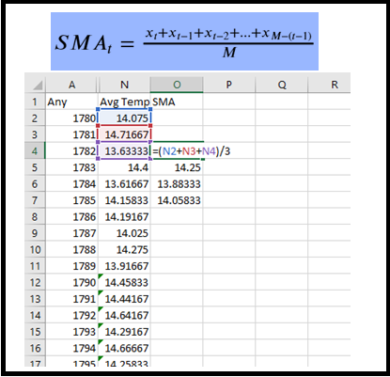
The Simple Moving Average (SMA) calculates the unweighted mean of the previous M or N points. We prefer selecting sliding window data points based on the amount of smoothing, as increasing the value of M or N improves smoothing but reduces accuracy.
To understand better, I will use the air temperature dataset.

Slide 12
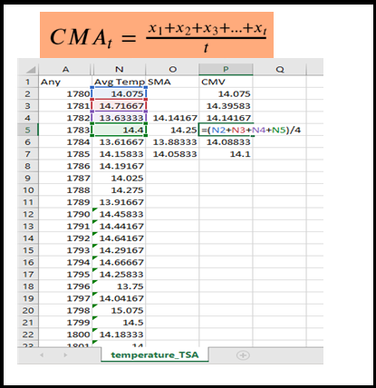
Cumulative Moving Average (CMA)
The CMA is the unweighted mean of past values till the current time.

Slide 13
ARIMA (Autoregressive Integrated Moving Average):
ARIMA, is a versatile model for analyzing and forecasting time series data. It decomposes the data into three key components:
Autoregression (AR): This component captures the influence of a series’ past values on its future values. In simpler terms, AR considers how past observations (lags) affect the current value. It’s denoted as AR(p), where ‘p’ represents the number of lagged observations included in the model.
Differencing (I): Stationarity is a crucial assumption for many time series analyses. Differencing involves subtracting a previous value from the current value, often required to achieve stationarity. The degree of differencing needed is denoted by I(d).
Moving Average (MA): This component accounts for the effect of past forecast errors (residuals) on the current prediction. It considers the average of past errors (lags) to improve the forecast accuracy. MA is denoted by MA(q), where ‘q’ represents the number of lagged errors incorporated in the model.

Slide 14
SARIMA(Seasonal Autoregressive Integrated Moving Average)
SARIMA (Seasonal ARIMA) builds upon ARIMA’s strengths by incorporating an additional dimension: seasonality. This is particularly beneficial for data exhibiting recurring patterns at fixed intervals, such as monthly sales data with holiday spikes. Here’s how SARIMA tackles seasonality:
Seasonal Autoregression (SAR): Similar to AR, SAR considers the influence of past seasonal values on the current value. It captures the impact of past seasonal patterns on future forecasts.
Seasonal Differencing (SI): Analogous to differencing, seasonal differencing focuses on removing seasonal patterns from the data to achieve stationarity.
Seasonal Moving Average (SMA): This component incorporates the influence of past seasonal forecast errors into the current prediction, similar to the moving average component in ARIMA.

Slide 15
Use-Cases
ARIMA:
Financial Forecasting: ARIMA models are widely used in finance for forecasting stock prices, currency exchange rates, and other financial metrics. Traders and investors rely on ARIMA to make informed decisions about buying and selling securities based on historical price trends.
Demand Forecasting: ARIMA is employed in various industries, including retail, manufacturing, and logistics, to forecast demand for products or services. Companies use ARIMA to optimize inventory management, production planning, and resource allocation based on anticipated demand fluctuations.
Economic Analysis: ARIMA models are utilized by economists and policymakers to analyze and forecast economic indicators such as GDP growth, inflation rates, and unemployment rates. These forecasts inform monetary and fiscal policies, business strategies, and investment decisions.
Traffic and Transportation Management: ARIMA models can be applied to analyze and predict traffic patterns, public transportation ridership, and travel demand. Urban planners and transportation authorities use ARIMA forecasts to optimize traffic flow, plan infrastructure projects, and enhance public transit services.

Slide 16
SARIMA:
Retail Sales Forecasting: SARIMA models are commonly used in retail to forecast sales of seasonal products, such as clothing, electronics, and holiday merchandise. Retailers leverage SARIMA forecasts to optimize inventory levels, plan promotions, and allocate resources effectively throughout the year.
Energy Consumption Prediction: SARIMA is employed in the energy sector to forecast electricity demand, fuel consumption, and renewable energy generation. Utilities and energy providers use SARIMA models to optimize energy production, distribution, and pricing strategies, especially in regions with distinct seasonal variations in energy demand.
Weather Forecasting: SARIMA models are utilized by meteorologists and climate scientists to forecast seasonal weather patterns, including temperature, precipitation, and atmospheric conditions. SARIMA forecasts help in planning agricultural activities, managing natural disasters, and mitigating the impacts of extreme weather events.
Hospitality and Tourism: SARIMA is applied in the hospitality and tourism industry to predict seasonal fluctuations in hotel occupancy rates, airline passenger traffic, and tourist arrivals. Hotels, airlines, and travel agencies use SARIMA forecasts to adjust pricing, marketing campaigns, and capacity planning based on anticipated demand patterns.

Slide 17
When to use : ARIMA and SARIMA
Use ARIMA if:
Your data has no seasonality or very weak seasonal patterns.
Model interpretability is a priority. ARIMA’s simplicity makes it easier to understand the factors influencing forecasts.
You’re dealing with limited data. ARIMA’s fewer parameters can be advantageous in such cases.
Use SARIMA if:
Your data exhibits strong seasonality, like monthly sales figures with holiday spikes or quarterly customer churn.
You have a large dataset that captures multiple seasonal cycles. SARIMA’s ability to handle seasonality becomes more pronounced with more data.
Forecast accuracy is your main concern. SARIMA generally leads to more accurate predictions for seasonal data.

Slide 18
Advantages of SARIMA
Seasonal Modeling: SARIMA extends ARIMA by incorporating seasonal components, allowing it to capture and forecast seasonal patterns in time series data more effectively.
Improved Accuracy: By accounting for seasonal variations, SARIMA models can provide more accurate forecasts for datasets with prominent seasonal fluctuations.
Long-Term Forecasting: SARIMA is well-suited for long-term forecasting tasks where seasonal trends play a significant role, such as sales forecasting for seasonal products.
Disadvantages of SARIMA
Complexity: SARIMA models are more complex than traditional ARIMA models due to the inclusion of seasonal parameters, which may require additional expertise to implement and interpret accurately.
Data Requirements: SARIMA models require sufficiently long and detailed time series data to estimate the seasonal parameters accurately. Inadequate data may lead to unreliable forecasts.
Risk of Overfitting: SARIMA models with numerous seasonal parameters run the risk of overfitting, especially when applied to datasets with limited observations or noisy data.

Slide 19
Advantages of ARIMA
Simplicity: ARIMA is relatively simple to understand and implement, making it accessible to users with basic knowledge of time series analysis.
Versatility: It can handle a wide range of time series data, including stationary and non-stationary series, making it applicable in various domains.
Interpretability: The parameters of ARIMA models (e.g., autoregressive coefficients, moving average coefficients) can provide insights into the underlying dynamics of the time series.
Disadvantages of ARIMA
Assumption of Linearity: ARIMA assumes that the relationship between the observations and their lagged values is linear, which may not always hold true in real-world scenarios.
Limited Handling of Seasonality: ARIMA models are not explicitly designed to capture seasonal patterns in the data, which can lead to inaccuracies in forecasting for datasets with significant seasonal variations.
Parameter Selection: Determining the appropriate values for the ARIMA parameters (p, d, q) often requires experimentation and can be challenging, particularly for users without extensive experience in time series analysis.

